Slide 1




Diabetes
Data Analysis
by Doha Mohamed

Slide 2


hello
let’s start.....

Slide 3

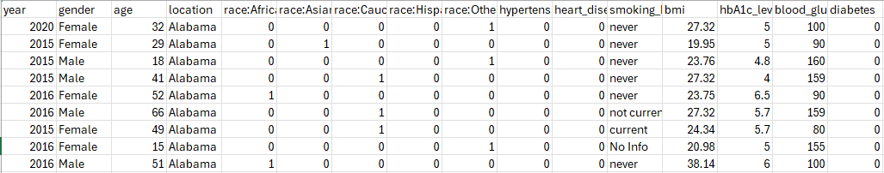

ايه ......
عباره عن

Slide 4

Let's count
the problems.......
1-All these are the columns of the category.

Slide 5
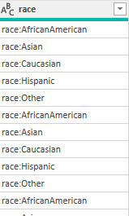
unpivoted
by power query
e

Slide 6
e
let’s go
to Python and SQL

Slide 7
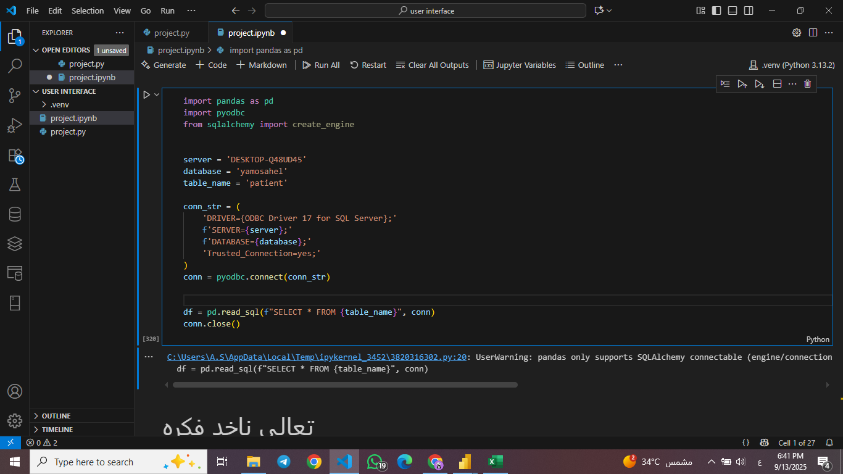
Let's connect

Slide 8
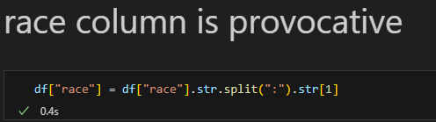
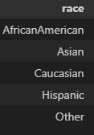
e

Slide 9
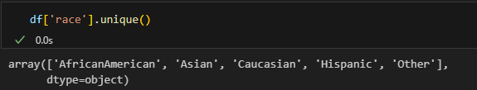
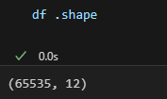
Don't you feel that there is too much repetition of five races 🙋‍♀️?
e

Slide 10
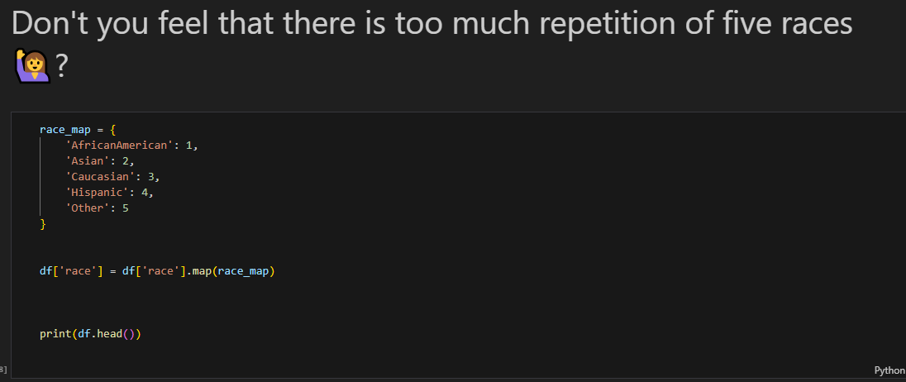
e

Slide 11
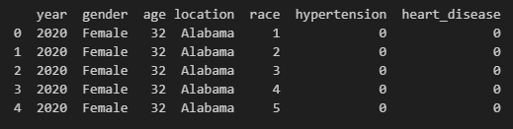
e

Slide 12
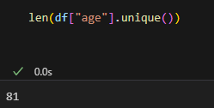
Let's count
the problems.......
2-age column

Slide 13
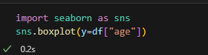
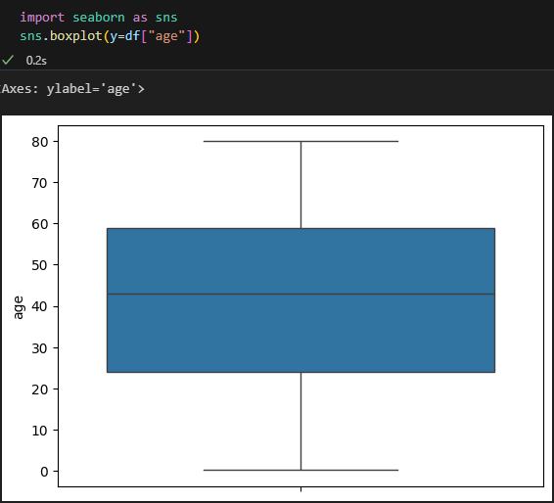
Is there
an outlier?.......

Slide 14
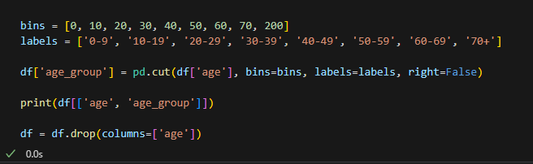

Slide 15
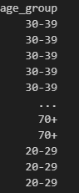

Slide 16
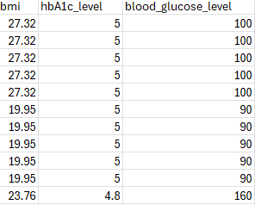
Let's count
the problems.......
3-حد فاهم الرقام دي عبارة عن اية

Slide 17
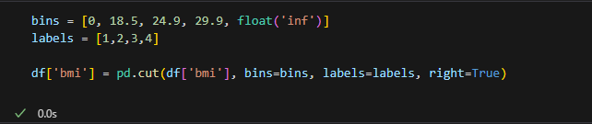
BMI

Slide 18
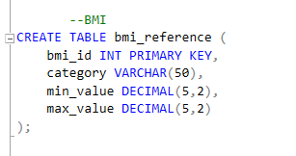
BMI

Slide 19
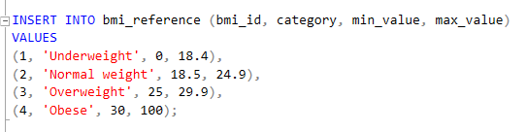
BMI

Slide 20
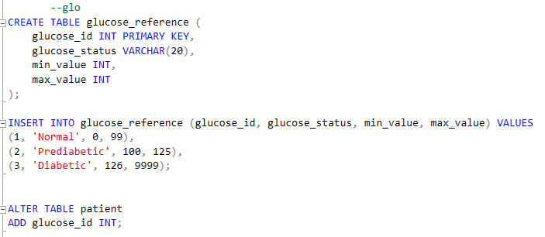
Glocose

Slide 21
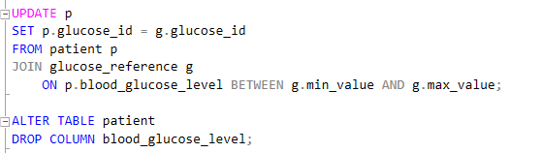
Glocose

Slide 22
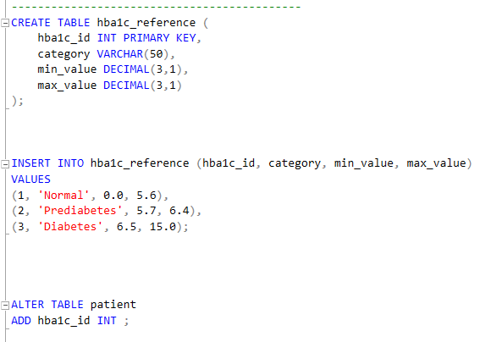
Hemoglobin

Slide 23
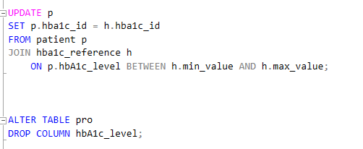
Hemoglobin

Slide 24
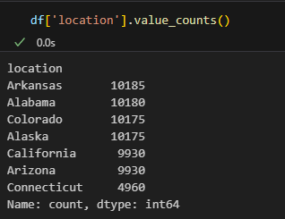
Let's count
the problems.......
3-Why don't we make a code for each region?

Slide 25
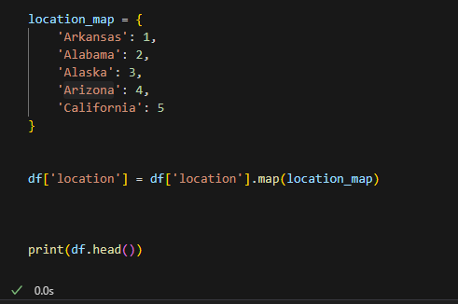

Slide 26
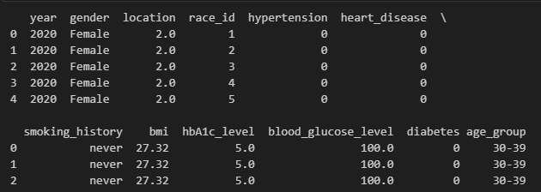

Slide 27
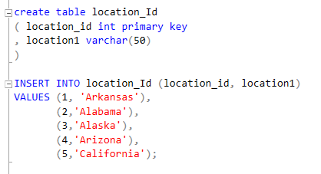

Slide 28
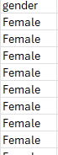
Let's count
the problems.......
4-We just reduce the space used.

Slide 29
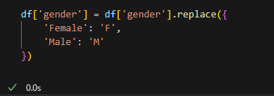
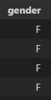

Slide 30
Let's count
the problems.......
5-Check the data type for the last time.

Slide 31
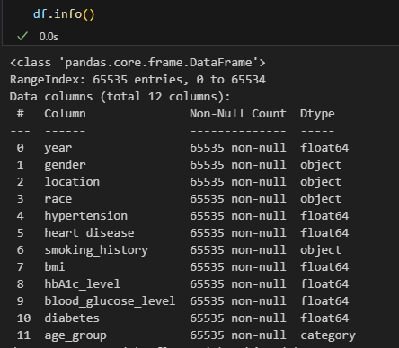

Slide 32
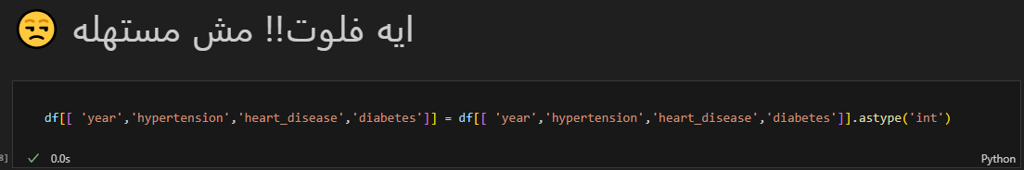
فلوت مش مستهلة

Slide 33
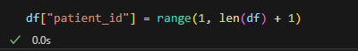

Slide 34
...in the end

Slide 35
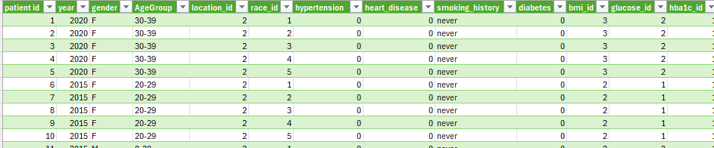
Patient

Slide 36
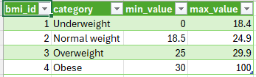
BMI

Slide 37
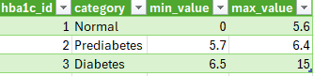
Hemoglobin

Slide 38
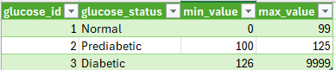
Glucose

Slide 39
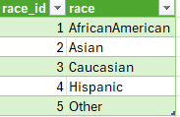
RACE

Slide 40
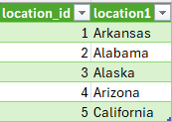
Location

Slide 41
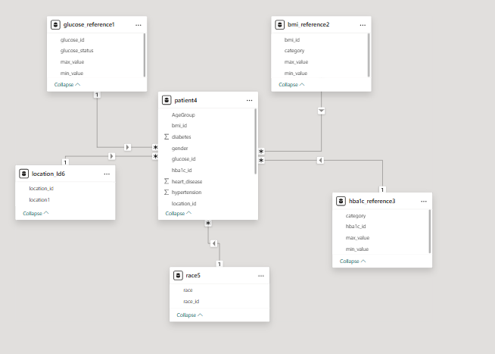

Slide 42
That's it....

